Slide 1

Organ Donation Management System.
A Mini Project Presentation on
Presented By:
MITHE MANASI GORAKH
NIMBALKAR DEVIKA DIGAMBAR
Patil VIVEK AMAR
Raut Ajinkya GOVARDHAN
T.E.-COMP 2024-25
Under Guidance of:
Prof. V.D.Mhaske
Department of Computer Engineering,
SVPM’s College of Engineering, Malegaon(Bk)

Slide 2
CONTENT
Introduction
Goals
Software and Hardware Requirements
Scope of Project
Modules
Program
Advantages
Conclusion
References

Slide 3
INTRODUCTION
The Organ Donation Management System is designed to address these issues by creating a streamlined platform that brings together donors, patients, hospitals, and medical staff.
This system simplifies donor registration, improves communication, and allows hospitals to efficiently track donations and manage the transplant process.
By reducing delays and enhancing coordination, the system maximizes the chances of successful transplants, ensuring that every organ donation opportunity is used to its fullest potential, ultimately saving more lives.
The system collects and analyzes data to identify trends and improve the organ donation process, helping to inform policies and strategies that can enhance overall efficiency.

Slide 4
GOALS
Simplify Donor Registration.
Centralized Data Management.
Real-time Notifications for Patients.
Increase Organ Donation Awareness.
Support Medical Staff Efficiency.

Slide 5
SOFTWARE & HARDWARE REQUIREMENTS
1. HARDWARE REQUIREMENTS
Processor: Intel Core i5 or higher
RAM: 4GB
Hard disk: 100GB of free space
Other: Network interface card, Printer (for reports)
2. SOFTWARE REQUIREMENTS
Operating System: Windows
Development Environment: JDK 22
Database: MySQL
IDE: Eclipse

Slide 6
SCOPE OF PROJECT
User Registration and Management.
Data Management and Reporting.
Real-Time Notifications and Updates.
Compliance and Security.
Future Scalability and Integration.

Slide 7
MODULS
Donor Module: Provide update or withdraw consent for organ donation.
Doctor Module:Facilitate communication and collaboration among healthcare professionals.
Organization Module:Register and manage profiles for hospitals and transplant organizations.
Patient Module:Get alerts for organ availability, appointments, and health updates.

Slide 8
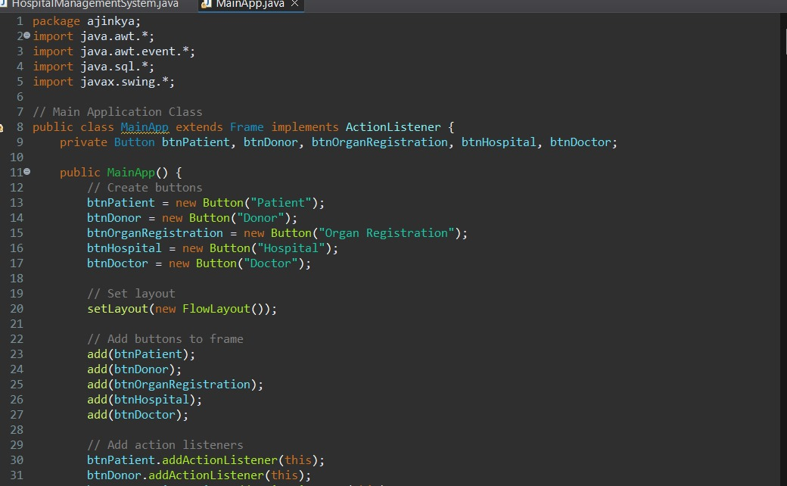
1.PROGRAM

Slide 9
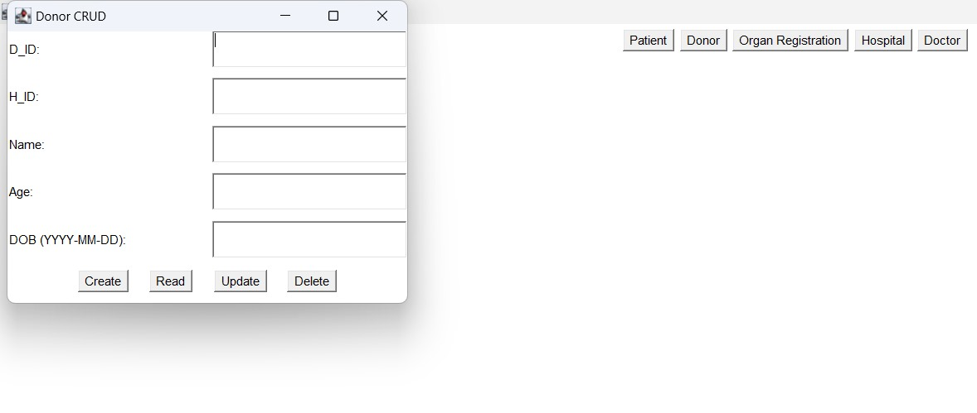
2. Donor CRUD

Slide 10
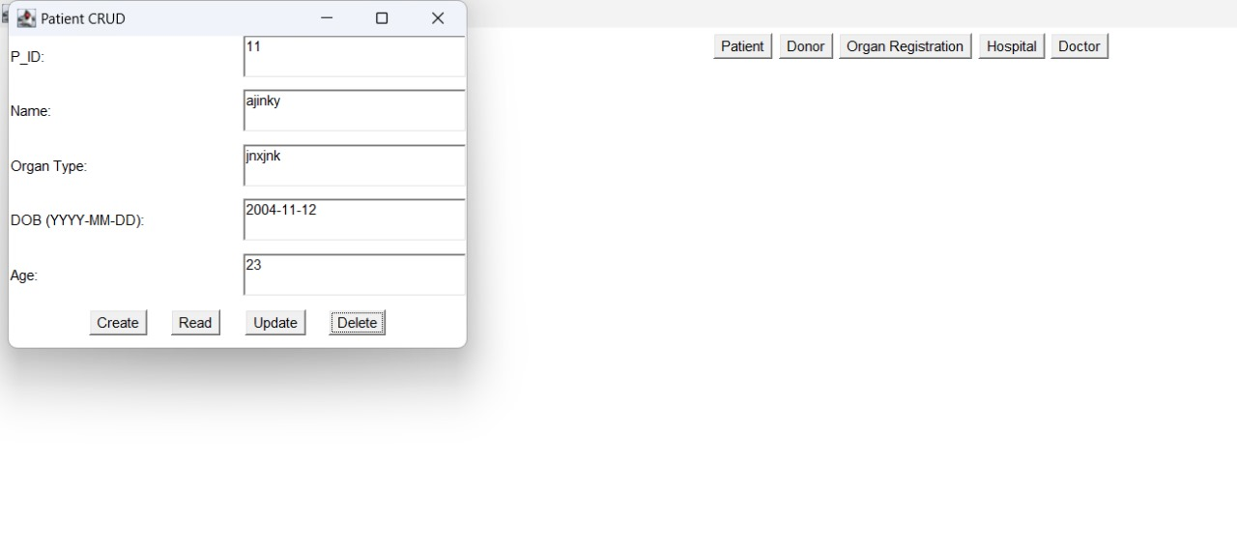
7. Patient CRUD

Slide 11
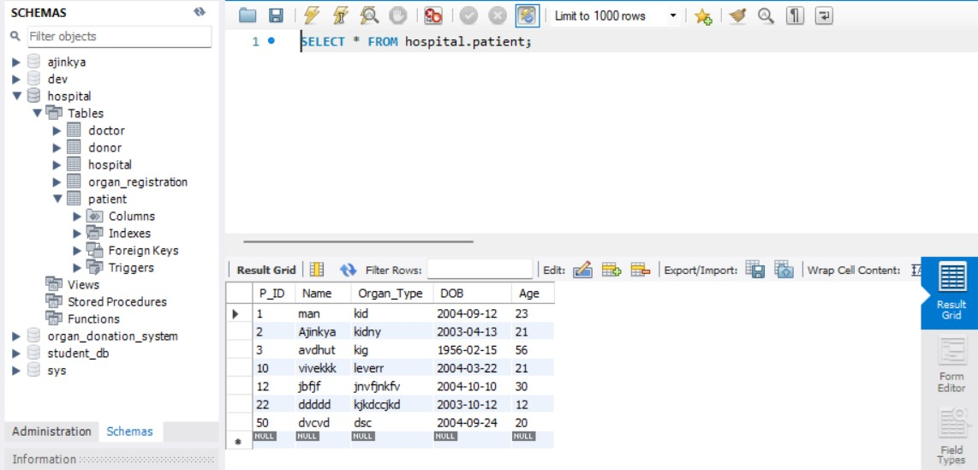
4. MySQL Database

Slide 12
ADVANTAGES
Increased Awareness and Education
Support Services for Families
User-Friendly Interface
Centralized Data Management
Real-Time Notifications
Regulatory Compliance and Data Security

Slide 13
CONCLUSION
The Organ Donation Management System enhances the efficiency and accuracy of organ donation by streamlining donor-recipient matching and centralizing data management. It provides real-time notifications and promotes awareness, ensuring compliance with legal standards while maintaining data security. By optimizing logistics and humanizing the donation process, the system bridges the gap between donors and recipients, offering hope to countless lives.

Slide 14
REFERENCES
Hernandez, E. and others. Data Analysis in Organ Donation Management Systems, 2022.
Lee, Y. and others. Mobile Applications for Organ Donation: A Review, 2021
Murray, T. H. and others. Ethical Dilemmas in Organ Allocation, 2020.
Alderson, D. and others. Logistical Challenges in Organ Procurement, 2020.

Slide 15
THANK YOU

